Slide 1
Neural Network Architectures
Geoff Hulten

Slide 2
Neural Network Architectures/Concepts
Fully connected layers
Convolutional Layers
MaxPooling
Activation (ReLU)
Softmax
Recurrent Networks (LSTM & attention)
Embeddings
Residual Networks
Batch Normalization
Dropout
Patience

Slide 3
Neural Network Architectures
Why Architecture
Encourage the network to capture important features of your domain
Control complexity and avoid problems at training time
Standard reusable structure, like feature engineering

Slide 4
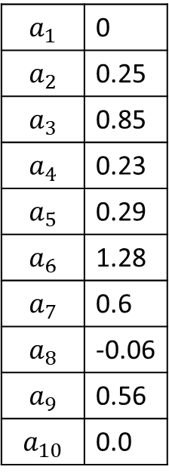
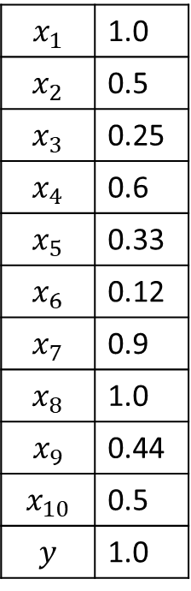
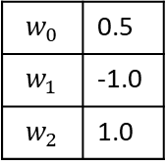
Convolutional Layer
$$x_{1}$$ | 1.0
$$x_{2}$$ | 0.5
$$x_{3}$$ | 0.25
$$x_{4}$$ | 0.6
$$x_{5}$$ | 0.33
$$x_{6}$$ | 0.12
$$x_{7}$$ | 0.9
$$x_{8}$$ | 1.0
$$x_{9}$$ | 0.44
$$x_{10}$$ | 0.5
$$y$$ | 1.0
$$a_{1}$$ | 0
$$a_{2}$$ | 0.25
$$a_{3}$$ | 0.85
$$a_{4}$$ | 0.23
$$a_{5}$$ | 0.29
$$a_{6}$$ | 1.28
$$a_{7}$$ | 0.6
$$a_{8}$$ | -0.06
$$a_{9}$$ | 0.56
$$a_{10}$$ | 0.0
$$w_{0}$$ | 0.5
$$w_{1}$$ | -1.0
$$w_{2}$$ | 1.0
Pad | 0.0
Alternative: output smaller than input

Slide 5
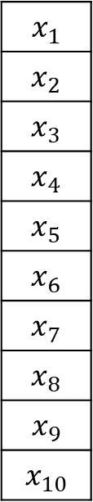
Types of Convolutional Filters
$$x_{1}$$
$$x_{2}$$
$$x_{3}$$
$$x_{4}$$
$$x_{5}$$
$$x_{6}$$
$$x_{7}$$
$$x_{8}$$
$$x_{9}$$
$$x_{10}$$
1x2
2x2
Red Channel
2x2x3
Green Channel
255 | 255 | 255
0 | 0 | 255
0 | 0 | 0
Blue Channel
1x3
255 | 0 | 0
255 | 0 | 0
255 | 255 | 0
3x3
255 | 0 | 0
0 | 128 | 0
0 | 0 | 64
1x4
2x3
1xN
MxN
MxNxD
1d
2d
3d

Slide 6



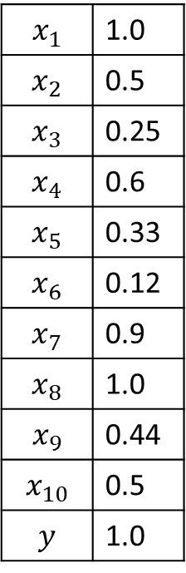



Convolutional Layer
$$a_{1.1}$$
$$a_{1.2}$$
$$a_{1.3}$$
$$a_{1.4}$$
$$a_{1.5}$$
$$a_{1.6}$$
$$a_{1.7}$$
$$a_{1.8}$$
$$a_{1.9}$$
$$a_{1.10}$$
$$w_{1.0}$$
$$w_{1.1}$$
$$w_{1.2}$$
$$x_{1}$$ | 1.0
$$x_{2}$$ | 0.5
$$x_{3}$$ | 0.25
$$x_{4}$$ | 0.6
$$x_{5}$$ | 0.33
$$x_{6}$$ | 0.12
$$x_{7}$$ | 0.9
$$x_{8}$$ | 1.0
$$x_{9}$$ | 0.44
$$x_{10}$$ | 0.5
$$y$$ | 1.0
$$a_{2.1}$$
$$a_{2.2}$$
$$a_{2.3}$$
$$a_{2.4}$$
$$a_{2.5}$$
$$a_{2.6}$$
$$a_{2.7}$$
$$a_{2.8}$$
$$a_{2.9}$$
$$a_{2.10}$$
$$w_{2.0}$$
$$w_{2.1}$$
$$w_{2.2}$$
…
…
$$a_{n.1}$$
$$a_{n.2}$$
$$a_{n.3}$$
$$a_{n.4}$$
$$a_{n.5}$$
$$a_{n.6}$$
$$a_{n.7}$$
$$a_{n.8}$$
$$a_{n.9}$$
$$a_{n.10}$$
$$w_{n.0}$$
$$w_{n.1}$$
$$w_{n.2}$$
Input
Filters
Activations

Slide 7


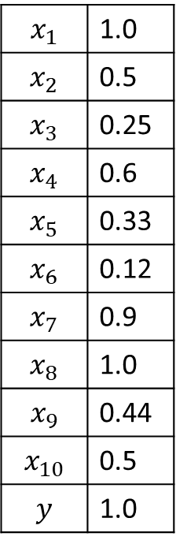

Some Intuition about Convolutions
$$0.01$$
$$0.12$$
$$0.30$$
$$0.88$$
$$0.93$$
$$0.72$$
$$0.31$$
$$0.12$$
$$0.05$$
$$0.01$$
$$x_{1}$$ | 1.0
$$x_{2}$$ | 0.5
$$x_{3}$$ | 0.25
$$x_{4}$$ | 0.6
$$x_{5}$$ | 0.33
$$x_{6}$$ | 0.12
$$x_{7}$$ | 0.9
$$x_{8}$$ | 1.0
$$x_{9}$$ | 0.44
$$x_{10}$$ | 0.5
$$y$$ | 1.0
Each filter initialized with random weights
Through training will learn to represent properties important to task
Response will be high where property exists in input
Although filters might not have clear simple semantics like these examples
Eye
Corner
$$0.03$$
$$0.55$$
$$0.60$$
$$0.35$$
$$0.22$$
$$0.12$$
$$0.21$$
$$0.04$$
$$0.02$$
$$0.03$$
Bridge
of
Glasses
…
…
$$0.81$$
$$0.91$$
$$0.88$$
$$0.34$$
$$0.03$$
$$0.02$$
$$0.07$$
$$0.02$$
$$0.01$$
$$0.01$$
Eyebrow

Slide 8



Some Intuition about Layers of Convolutions
$$0.01$$
$$0.12$$
$$0.30$$
$$0.88$$
$$0.93$$
$$0.72$$
$$0.31$$
$$0.12$$
$$0.05$$
$$0.01$$
Second layer looks for responses across filters
Composites create richer structures/concepts
Concepts may not be so clear as in the example
Eye
Corner
POSSIBLE
Eye
Structure
$$0.03$$
$$0.55$$
$$0.60$$
$$0.35$$
$$0.22$$
$$0.12$$
$$0.21$$
$$0.04$$
$$0.02$$
$$0.03$$
NON
Eye
Structure
Bridge
of
Glasses
$$0.81$$
$$0.91$$
$$0.88$$
$$0.34$$
$$0.03$$
$$0.02$$
$$0.07$$
$$0.02$$
$$0.01$$
$$0.01$$
Young
Eye
Structure
Eyebrow
First Convolutional
Layer
Second Convolutional
Layer

Slide 9


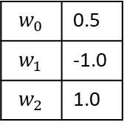


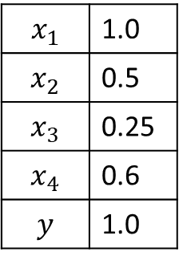







Backprop with Convolutional Layers
Forward Propagation
Back Propagation
Update Weights
Shared
Weights
$$w_{0}$$ | 0.5
$$w_{1}$$ | -1.0
$$w_{2}$$ | 1.0
$${∆w}_{0}=∝δ_{1,2}+ ∝δ_{2,3}+ ∝δ_{3,4}+ ∝δ_{4,p}$$
$$δ_{o}=y^{^}(1−y^{^})(y−y^{^})$$
$${∆w}_{1}=∝δ_{1,2}x_{1 }+ ∝δ_{2,3}x_{2 }+ ∝δ_{3,4}x_{3}+ ∝δ_{4,p}x_{4}$$
$$δ_{h}=o_{h} (1−o_{h})\sum_{kεOutputs}{w_{kh}δ_{k}}$$
$${∆w}_{2}=∝δ_{1,2}x_{2 }+ ∝δ_{2,3}x_{3 }+ ∝δ_{3,4}x_{4}$$
$$δ_{1,2}$$
${∆w}_{i}=∝δ_{hj}x_{i}$
$$x_{1}$$ | 1.0
$$x_{2}$$ | 0.5
$$x_{3}$$ | 0.25
$$x_{4}$$ | 0.6
$$y$$ | 1.0
$$δ_{2,3}$$
$$δ_{o}$$
$$y^$$
$$δ_{3,4}$$
$$δ_{4,p}$$
Unrolled
1x2
Filter
Pad | 0.0
Convolutional Layer

Slide 10


Pooling (Sampling)
$$x_{1}$$ | 1.0
$$x_{2}$$ | 0.5
$$x_{3}$$ | 0.25
$$x_{4}$$ | 0.6
$$x_{5}$$ | 0.33
$$x_{6}$$ | 0.12
$$x_{7}$$ | 0.9
$$x_{8}$$ | 1.0
$$x_{9}$$ | 0.44
$$x_{10}$$ | 0.5
$$y$$ | 1.0
$$0.01$$
$$0.12$$
$$0.30$$
$$0.88$$
$$0.93$$
$$0.72$$
$$0.31$$
$$0.12$$
$$0.05$$
$$0.01$$
May not matter exactly where the filter had a response
Just if there was a response and roughly where
Combine multiple responses into a single one
  Averaging
  Max Pooling
Faster, fewer parameters, more robust to small changes of input
$$0.12$$
$$0.88$$
$$0.93$$
$$0.31$$
0.05
Eye
Corner
Filter: 1x2
Stride: 2
Convolution
Layer
Max Pooling
Layer

Slide 11



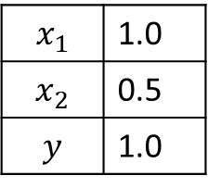



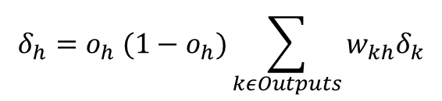
Backprop with Max Pooling
Forward Propagation
Back Propagation
Update Weights
Shared
Weights
$$w_{0}$$ | 0.5
$$w_{1}$$ | 0.5
$$w_{2}$$ | 1.0
$$x_{1}$$ | 1.0
$$x_{2}$$ | 0.5
$$y$$ | 1.0
$$δ_{p}$$
1.5 -> .82
$$δ_{p}$$
.82
$$δ_{o}$$
$$y^$$
$$0$$
.75 -> .68
Unrolled
1x2
Filter
$$δ_{h}=o_{h} (1−o_{h})\sum_{kεOutputs}{w_{kh}δ_{k}}$$
Pad | 0.0
Max Pooling
Filter 1x2
Stride 2
(No activation)

Slide 12
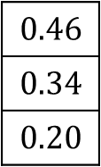

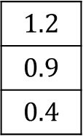
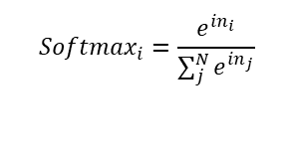
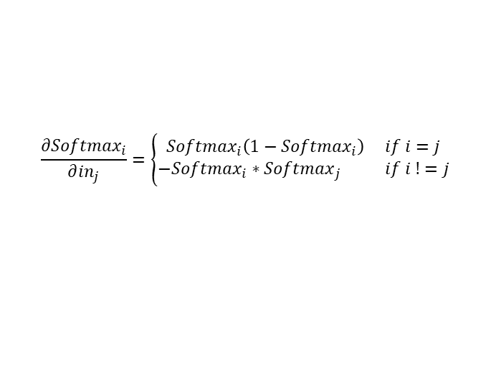


Softmax
Output Layer
$$1.2$$
$$0.9$$
$$0.4$$
$$0.46$$
$$0.34$$
$$0.20$$
Sigmoid
Activation
$$P(eyeOpened)$$
Softmax
$${Softmax}_{i}=\frac{e^{{in}_{i}}}{\sum_{j}^{N}{e^{{in}_{j}}}}$$
Sigmoid
Activation
$$P(eyeHalfOpened)$$
Arbitrary
Activations
Sum to
1.0
Sigmoid
Activation
$$P(eyeClosed)$$
$$\frac{{∂Softmax}_{i}}{∂{in}_{j}}=\left\{\begin{aligned}{Softmax}_{i}\left(1−{Softmax}_{i}\right) if i=j \\ −{Softmax}_{i}{ ∗Softmax}_{j} if i !=j\end{aligned}\right.$$

Slide 13
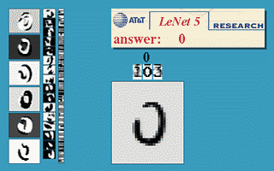
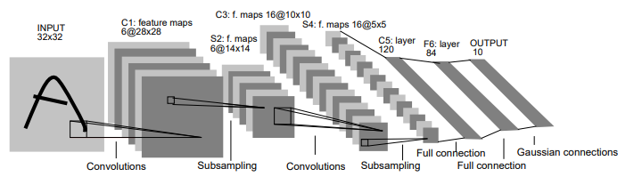
LeNet-5
2d → 1d
400 activations
1 output per digit
5x5 Filters
Stride 1
No Padding
2x2 Filters
Stride 2
Average Pooling
1998 paper
Sigmoid Activations
~60,000 parameters
http://yann.lecun.com/exdb/publis/pdf/lecun-01a.pdf

Slide 14
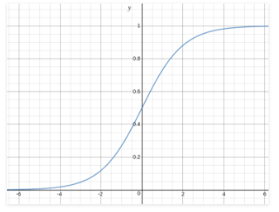
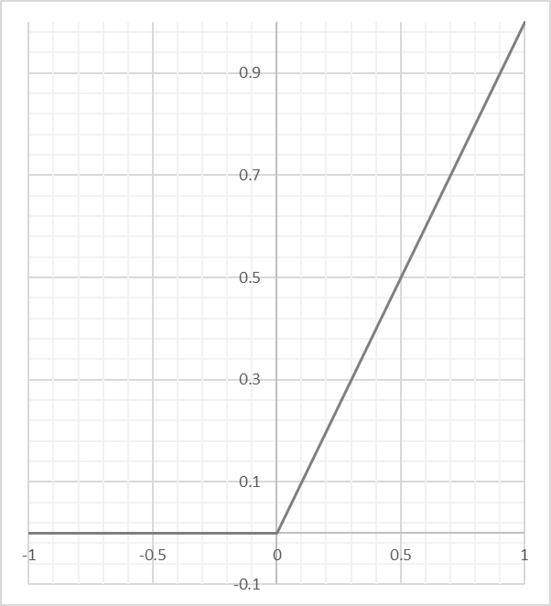
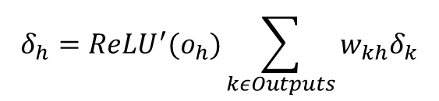
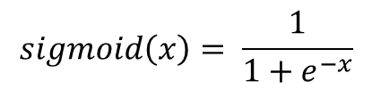


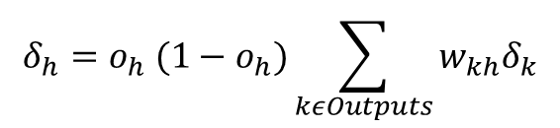
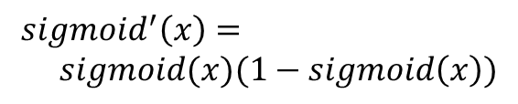
Activation (ReLU)
Advantages:
Computationally Faster
Gradients not squeezed
Large net convergence
Activation sparsity
Non-advantages:
Dead Neurons
Less non-linear (?)
Sigmoid Activation
ReLU Activation
Visualization
$$sigmoid\left(x\right)= \frac{1}{1+e^{−x}}$$
$ReLU\left(x\right)=x if x>0 else 0$
Forward Pass
$${sigmoid}^{′}\left(x\right)= \\ sigmoid(x)(1−sigmoid\left(x\right))$$
$${ReLU}^{′}\left(x\right)=1 if x>0 else 0$$
Derivative
$$δ_{h}=o_{h} (1−o_{h})\sum_{kεOutputs}{w_{kh}δ_{k}}$$
$$δ_{h}={ReLU}^{′}(o_{h})\sum_{kεOutputs}{w_{kh}δ_{k}}$$
Backprop

Slide 15
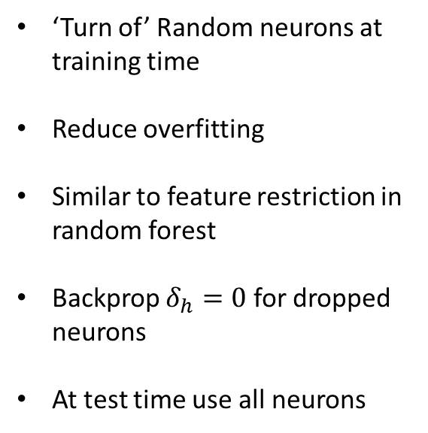

Dropout
‘Turn of’ Random neurons at training time
Reduce overfitting
Similar to feature restriction in random forest
Backprop $δ_{h}=0$ for dropped neurons
At test time use all neurons
Performance Time – use them all
Train Iteration 2
Train Iteration 1
Train Iteration 3
$$P(y=1)$$
Hidden Layer
Hidden Layer
Output Layer

Slide 16
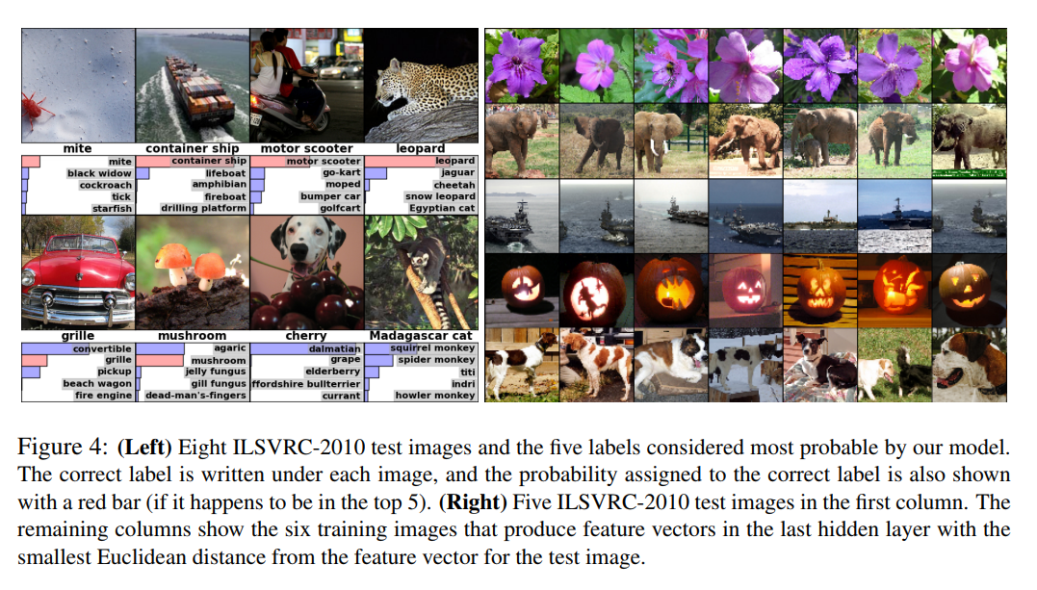
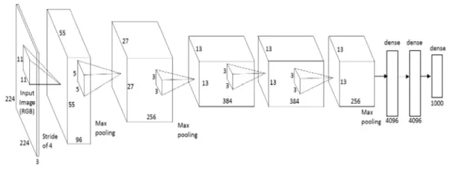
Alex Net
Convolution:
More of it!
2012 paper 17% @5
Relu Activation
60 million parameters
Reduce overfitting
  Data augmentation
    Cropping, rotating
    Modifying Principal Components
  Dropout (50% rate)
    First two fully connect layers
Convolution:
96 11x11x3 Filters
Stride 4
Convolution:
256 5x5x96 Filters
Stride 1
Convolution:
384 3x3x256 Filters
Stride 1
Fully Connected ->
Output
Max Pooling:
3x3 Filters
Stride 2
Max Pooling:
3x3 Filters
Stride 2
Real architecture is a bit different: Split across GPUs
https://papers.nips.cc/paper/4824-imagenet-classification-with-deep-convolutional-neural-networks.pdf

Slide 17
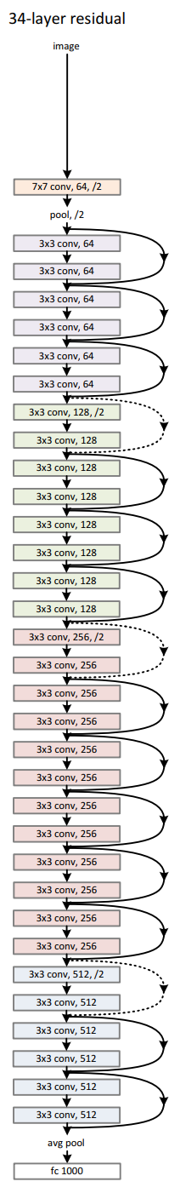
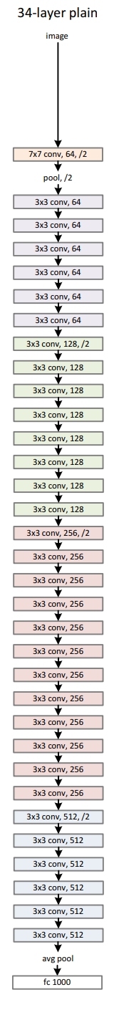
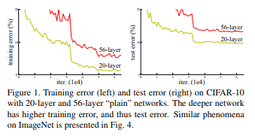
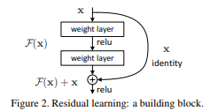

ResNet
Image 224x224
Search failing
Training lower network, not upper
Output 56x56
Convolution:
64 7x7x3 Filters
Stride 2
Max Pooling:
2x2 Filters
Stride 2
Residual Blocks:
64 3x3x64 Filters
Stride 1
Convolution Block:
128 3x3x64 Filters
Stride 2
No Back channel
Output 28x28
2015 paper
60 million parameters
Ensemble at 152 layers
  Human level performance
Reduce Overfitting
  Data Augmentation
  Batch Normalization
    https://arxiv.org/pdf/1502.03167.pdf
Etc…
$w_{kh}δ_{k}$ → gradients getting stuck
https://arxiv.org/pdf/1512.03385.pdf
Fullly connected + softmax

Slide 18



Autoencoders
Helpful Intuitive First Step
Learn a mapping from a code to a sample
Network learn to reconstruct the sample (image)
$$x_{1}$$ | 0.1
$$x_{1}$$ | 0.2
$$x_{1}$$ | 0.3

Slide 19
Autoencoders
One way to use it:
Train a network
Throw away the decoder
Use the embeddings as input feature
  Sparse to dense – text
Learn encodings for training data
Bottleneck
(Embedding Layer)
Input
Output
Encoder
Decoder

Slide 20


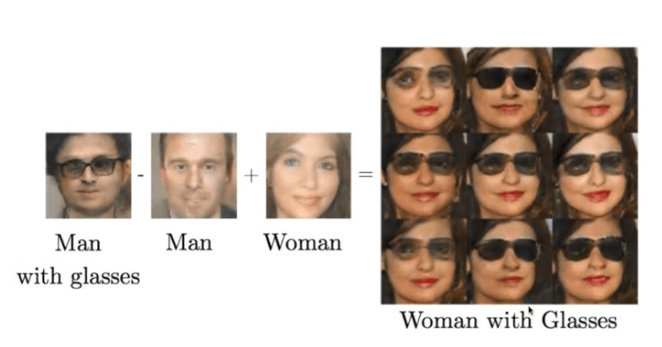

Variational Autoencoders (and GANs)
Delta in
Embedding Space
Another way to use an Autoencoder:
Train an autoencoder (slightly differently)
  Variational or GAN
Find embedding of object
Modify embedding
Decode the new embedding
Me
Without Glasses
Me
With Glasses
Decode this spot
Embedding Dimension 2
Found on several websites:
You
Without Glasses
You
With Glasses
Embedding Dimension 1
Variational Autoencoders: https://arxiv.org/pdf/1606.05908.pdf
GAN Paper: https://arxiv.org/pdf/1406.2661.pdf

Slide 21
Machine Translation
TBD
https://arxiv.org/pdf/1609.08144.pdf

Slide 22
Neural Network Architectures/Concepts
Fully connected layers
Convolutional Layers
MaxPooling
Activation (ReLU)
Softmax
Recurrent Networks (LSTM & attention)
Embeddings
Residual Networks
Batch Normalization
Dropout
Patience

Slide 23
Summary
The right network architecture is key to success with neural networks
Architecture engineering takes the place of feature engineering
Not easy – and things are changing rapidly
But if you:
  Are in a domain with existing architectures
  Have a lot of data
  Have GPUs for training
  Need to chase the best possible accuracies
Try Neural Networks

